Slide 1

Are the Browns Losing Seasons The Fault of Cleveland Weathers?

Slide 2

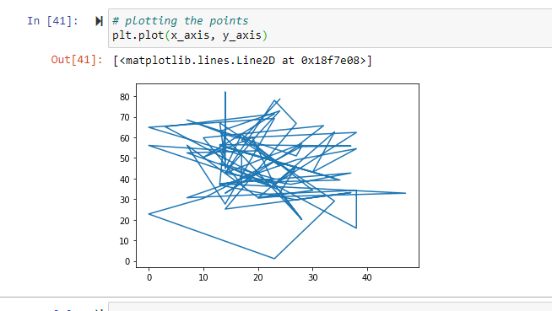
Hypothesis: the browns losses absolutely have everything to do with the weather!

Slide 3
Research Questions to be Answered:
1. Is there a correlation between Browns wins or losses in wet weather in Cleveland, Ohio?
2. Is there a correlation between Browns wins or losses in dry weather in Cleveland, Ohio?
3. Is there a correlation between total rainfall versus Browns total game points?
4. Is there a correlation between temperature versus Browns total game points?

Slide 4
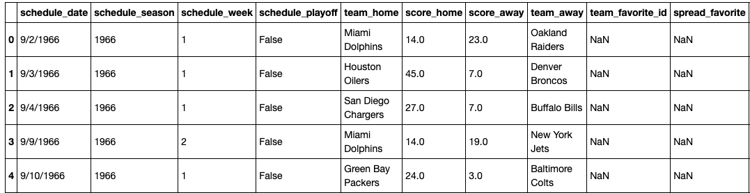
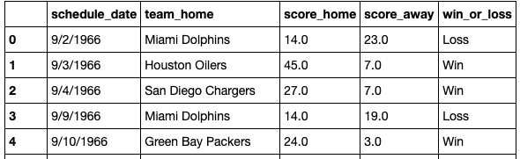
Data Gathering
Gathered data from Kaggle
Data Sources
Kaggle
https://www.kaggle.com/tobycrabtree/nfl-scores-and-betting-data?select=spreadspoke_scores.csv
Added Win/Loss columns

Slide 5
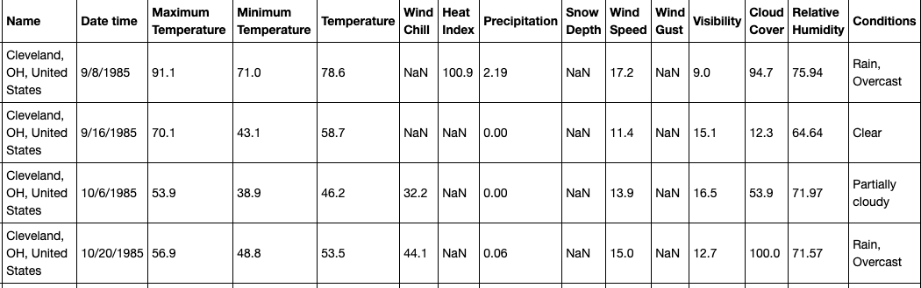
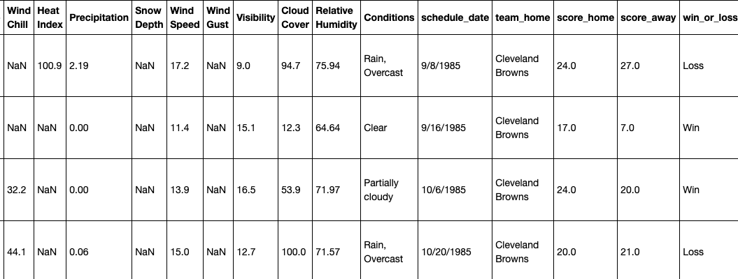
Data Gathering (Continued)
Gathered data from Weather Data Services
Data Sources
Weather Data Services API
https://www.visualcrossing.com/weather/weather-data-services#
Picture of data set 2
Combined Weather data and Kaggle data

Slide 6
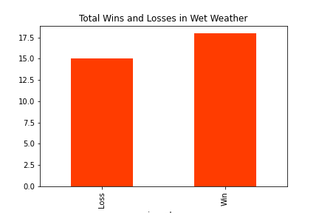
Is there a correlation between Browns wins or losses in wet weather in Cleveland, Ohio?

Slide 7
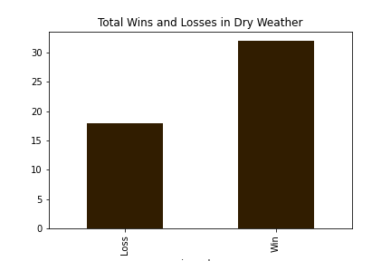
Is there a correlation between Browns wins or losses in dry weather in Cleveland, Ohio?

Slide 8
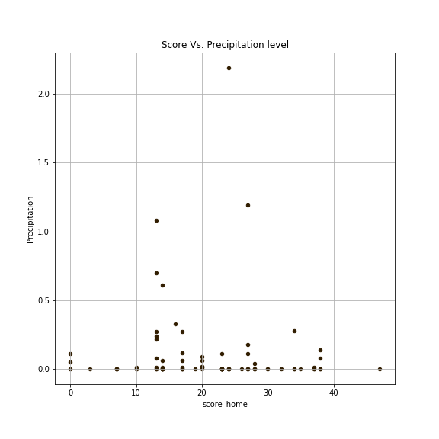
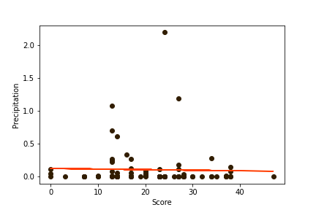
Is there a correlation between total rainfall versus Browns total game points?

Slide 9
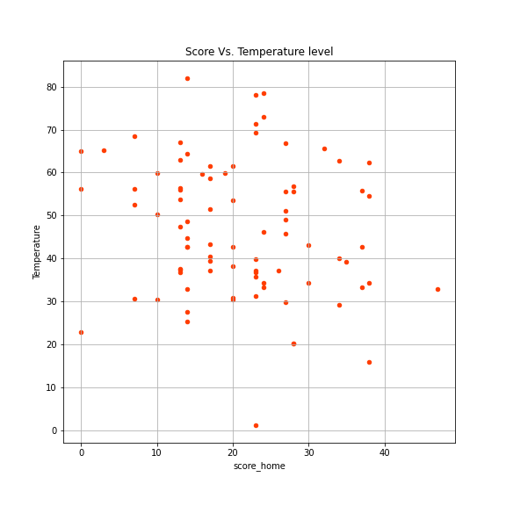
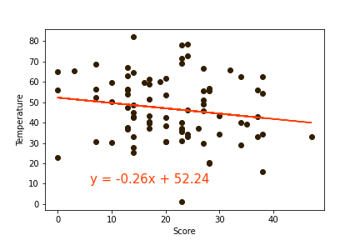
Is there a correlation between temperature versus Browns total game points?

Slide 10
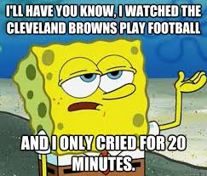
Conclusion
The Browns losing (1985-1994) is not related to the weather, but we’re sure there is another reason for it!

Slide 11
Special Thanks
Julie Kitzler
Michelle Fegatelli
Luke Fedeli
Mel Sabo
Jah

